Slide 1
Cartridge Case Project: Behind the Scenes
Francesca Spencer

Slide 2
Task 1: Inventory
I went through two of the crates in about a week and a half and matched the codes on the cartridges to the codes on the 150 page master list
I color coordinated the master list with the cartridges we have so we can easily find them in the future

Slide 3
Task 2: New Codes
To make the codes easier to understand for subsampling, Dr. Carriquiry came up with a new format for the codes
They include whether the cartridge was Known or Questioned, what group it came from, what set it came from, what gun it came from, and the sample number
Ex: K002uK1

Slide 4
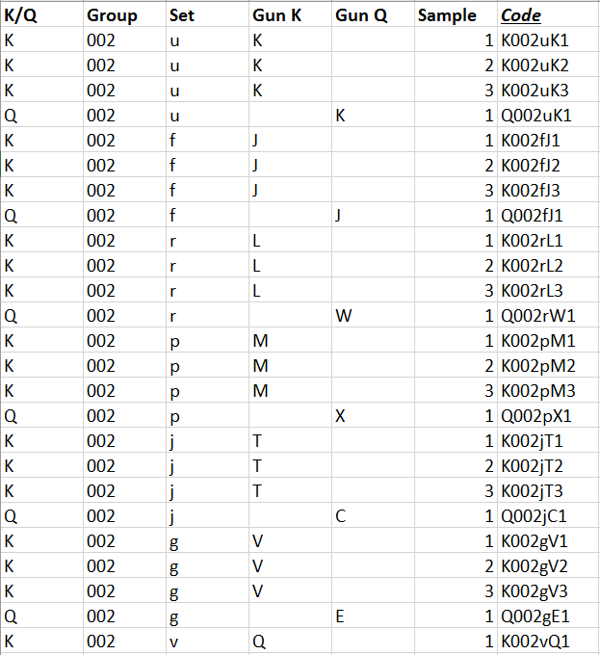
Excel
To easily get the codes from the combined columns, I used the command:
=(A2&""&B2&""&C2&""&D2&""&F2)
The guns were unique for every set and there was no pattern so they were entered manually (~5ish hours per line of guns)
The 15 sets were changed from numbers to random letters
After entering all the codes, I found there were 14,880 cartridges (we’re missing about 3,000+)

